Slide 1
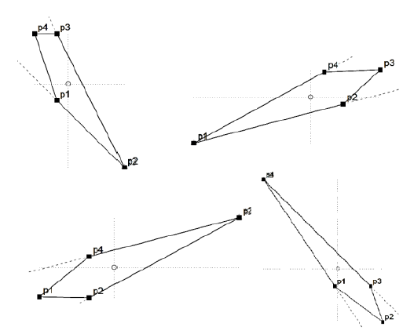
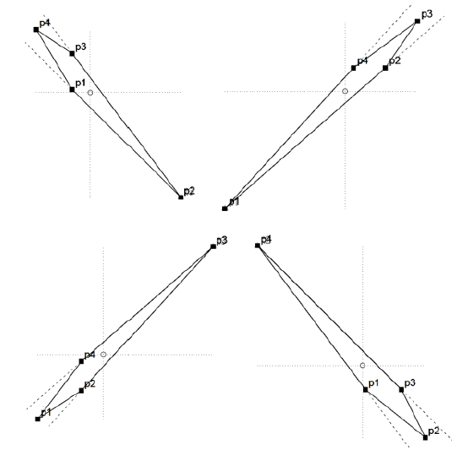
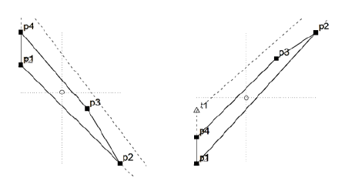
Coordinate Orientation for Reliable Quadrilateral Shape Parameters
Nicholas Senatore

Slide 2
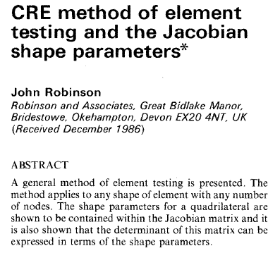


What is this project about?
Quadrilateral meshes (from triangles) are often used for computational analysis, graphical representation, and modeling.
1986 paper by John Robinson
Engineering Computations journal
Suggests a quadrilateral can be described by three/four parameters:
Aspect Ratio
Skew angle
Two tapers (X and Y)
These are calculated in two ways:
Employing the Jacobian matrix (explained within paper)
Employ alternative approach using systematic drawing procedure (explained within paper)
What is the goal, then?
Create a program that can take in various quads, calculate these six values for a given quad, and then decipher if there is a better orientation for these quadrilaterals to lessen outliers.

Slide 3
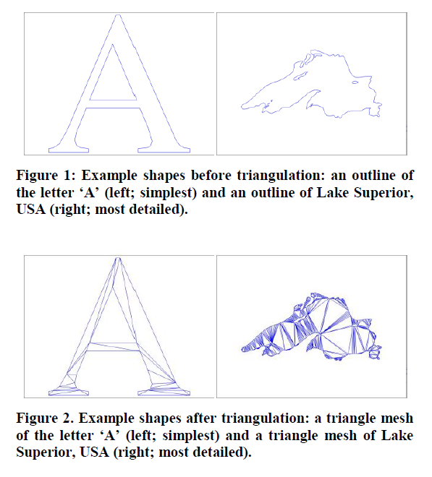
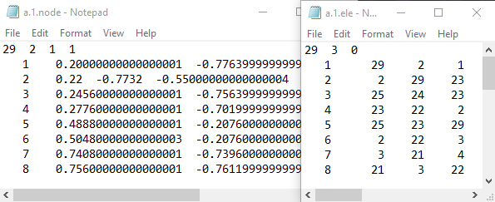
How is this accomplished?
Read in .node (assign x and y to a point) and .ele files (combine three points to make a triangle)
Use the midpoint formula and centroid to create three quadrilaterals within a given triangle
Generate code for calculating aspect ratio, skew, and tapers in both Jacobian and Shape Parameters methodology
Output R code that will plot the quadrilateral and its triangle for easier visualization
Determine a way to obtain better results per calculation
Discovery!
Given a set of points {p1,p2,p3,p4}, different results obtained for Jacobian when the measures are calculated in these orders: <p1,p2,p3,p4> vs. <p2,p3,p4,p1> vs. <p4,p3,p1,p2> vs. <p4,p3,p2,p1>
Create an algorithm to ensure consistency!

Slide 4
QUAD ORIENTATION Shape Parameters & Jacobian Analysis

Slide 5
Coordinate Orientation
A graph has four quadrants. I (top right), II (top left), III (bot left), IV (bot right).
The centroid of the quad is calculated, thus becoming the origin reference point to decipher where the other points lie.
(x1 + x2 + x3 + x4) / 4 (y1 + y2 + y3 + y4) / 4
Once the centroid is calculated, cases are used to check:
To the right and above the centroid (I)
To the left and above the centroid (II)
To the left and below the centroid (III)
To the right and below the centroid (IV)
II
I
III
IV

Slide 6
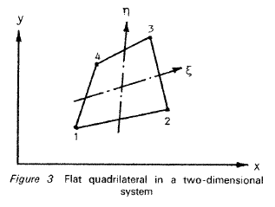
Coordinate Orientation
If there exists only one point in each quadrant, then:
Point in I is P3
Point in II is P4
Point in III is P1
Point in IV is P2
P4
P3
II
I
III
IV
P1
P2

Slide 7
Coordinate Orientation
This is not always the case, however, because two points could exist in one quadrant, while the other two are in other quadrants. One quadrant might even hold three points!
Variations include:
P4
P3
P3
II
I
II
I
II
I
P3
P4
P2
P4
P1
III
IV
III
IV
III
IV
P1
P1
P2
P2

Slide 8
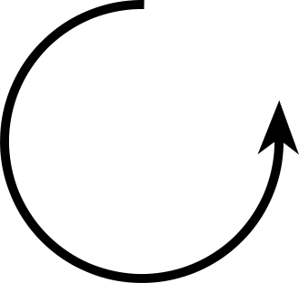
Coordinate Orientation
P4
II
I
P3
As a result, multiple cases need to be checked.
Four sub sections of if statements are used, each for the four quadrants.
Start by checking the bottom left most quadrant (III aka p1vals) and work your way around COUNTER CLOCKWISE.
Check to see if there are three points in this quadrant (two quadrants missing).
If so, you will save these points in an ArrayList, set a Boolean to indicate there are three points, continue counter clockwise to find the lone point, set that as it’s respective quadrant’s point (previous slide), and then later decipher the correct order of the three points using the line method described later.
Check to see if there are two points in this quadrant.
If so, decipher what other quadrants are missing points.
After this step, you can decipher which of the two points is which in the current quadrant. For example, if Quadrant III were populated with two points, they are either P1 and P4 OR P1 and P2. (Adjacent quadrants)
You need to check if there are two points in the opposite quadrant. If so, follow with the line method described later.
Check to see if there is only one point in this quadrant. If so, the point is that respective quadrant's point (see previous slide).
P1
III
IV
P2

Slide 9
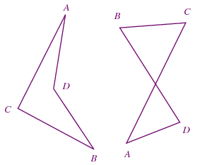
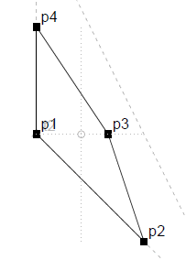
Assumptions
Concave
Crossed
Four points are used at all times
Not concave, but convex
Not three or four collinear points
Three would be a triangle, four would be a line
No points are overlapping / have both the same x and y value
Same X & Y as Centroid
Features / Capabilities
Order input does not matter / line method works with arbitrary points
Allows for both clockwise and counterclockwise
Corrects “crossed” quads, which have lines that intersect
Works with points that are the same x or y value as the centroid

Slide 10
Line Method, 3 Points
NOTE: .get(0) is always the arbitrary point that is being drawn to. The value it holds depends on the input.
For three points in one quadrant, one in other:
Once all of the main four if statements (one for each quadrant) are finished, four separate if statements check to see if there are three points in a given quadrant using the set Boolean.
If true for any quadrant, a line is calculated from the lone point (which will be deciphered by this point) to one of the three points using the y = mx + b formula.
p1val is an array that contains X [arr index 0] and Y [arr index 1] of the three pts ArrayList index of 0, which is one of the points, is arbitrarily chosen. The point chosen does not matter. slope = (p1val.get(0)[1] - p3[1]) / (p1val.get(0)[0] - p3[0]);
b = p3[1] - (slope * p3[0]);
We currently have m and b for the formula
P3
II
I
P4
III
IV
Arbitrarily chosen point
P1
P2

Slide 11
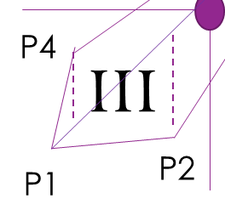
Line Method, 3 Points (Continued)
The two points that were NOT chosen are projected onto the line (plug x values in the equation)
The y values of the two points are compared to their y value on the line.
If the y value on the line is greater than a point’s y value, it is below the line like P2.
If the y value on the line is less than a point’s y value, it is above the line like P4.
y = m * x + b
tempy1 = (slope * p1val.get(1)[0]) + b;
tempy2 = (slope * p1val.get(2)[0]) + b;

Slide 12
Line Method, 3 Points (Continued)
If the line is above the other two points
if(p1val.get(1)[1] < tempy1 && p1val.get(2)[1] < tempy2){
You need to repeat the line method again, but this time you’re comparing the two points below the line to figure out their coordination. If you project p1val.get(2)[0] on the line…
if(p1val.get(2)[1] > tempy1Bot2){
p4 = p1val.get(0);
p1 = p1val.get(2);
p2 = p1val.get(1);
else if(p1val.get(2)[1] < tempy1Bot2){
p4 = p1val.get(0);
p1 = p1val.get(1);
p2 = p1val.get(2);

Slide 13
Line Method, 3 Points (Continued)
If the line is in-between the other two points
else if(p1val.get(1)[1] > tempy1 && p1val.get(2)[1] < tempy2){
p4 = p1val.get(1);
p1 = p1val.get(0);
p2 = p1val.get(2);
or
else if(p1val.get(1)[1] < tempy1 && p1val.get(2)[1] > tempy2){
p4 = p1val.get(2);
p1 = p1val.get(0);
p2 = p1val.get(1);

Slide 14
Line Method, 3 Points (Continued)
If the line is below the other two points
else if(p1val.get(1)[1] > tempy1 && p1val.get(2)[1] > tempy2){
You need to repeat the line method again, but this time you’re comparing the two points above the line to figure out their coordination. If you project p1val.get(2)[0] on the line…
if(p1val.get(2)[1] > tempy1Top2){
p4 = p1val.get(2);
p1 = p1val.get(1);
p2 = p1val.get(0);
else if(p1val.get(2)[1] < tempy1Top2){
p4 = p1val.get(1);
p1 = p1val.get(2);
p2 = p1val.get(0);

Slide 15
Line Method 2 & 2
NOTE: .get(0) is always the arbitrary point that is being drawn to. The value it holds depends on the input.
For two points in one quadrant, two in other:
y = mx + b formula used to create a line from the second point p2 (will have been decided) to one of the points on the opposite, diagonal quadrant. The point is chosen arbitrarily. Opposite / diagonal quadrant means the quadrant that is NOT touching the current quadrant to either the left or right. Opposite / diagonal quadrant pairs are III & I, and IV & II
p3val.get(0) is the arbitrarily chosen point tempSlope1 = (p3val.get(0)[1] - p2[1]) / (p3val.get(0)[0] - p2[0]);
double tempB1 = p2[1] - (tempSlope1 * p2[0]);
We currently have m and b for the formula
Arbitrarily chosen point
P4
II
I
P3
P1
III
IV
P2

Slide 16
Line Method 2 & 2 (Continued)
P4
II
I
P3
Project the x value of the point that was not chosen on the calculated line. If the y value of the point on the line is less than the actual point, then this is good. This means that a point was not left out of the shape. This is p3, the other point not chosen is p4. (See top right figure)
If the y value of the point on the line is greater than the actual point, then this is not good. This means that a point was left out of the shape. This is p4, the other point not chosen is p3. (See bottom right figure)
P1
III
IV
P2
P4
II
I
P3
P1
III
IV
P2

Slide 17
Line Method 2 & 2
P4
II
I
P3
Use the y = mx + b formula to calculate the line from p4 to p1 in the opposite quadrant.
The second point p2 is then placed on the line by its x value.
If the y value of the point on the line is greater than the actual point, then this is good. This means that the second point is not above the line from p4 to p1. (See top right figure)
If the y value of the point on the line is not greater than the actual point, then this is not good. This means that the second point is above the line from p4 to p1. (See bottom right figure)
P1
III
IV
P2
P4
II
I
P3
P2
III
IV
P1

Slide 18
DATA & GrAPHS

Slide 19
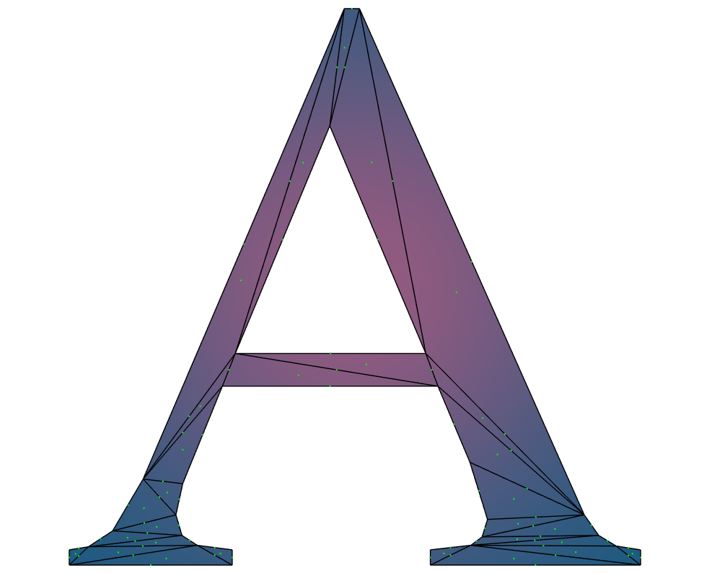
A.1
 | A.1
 | Jacobian
 | Aspect Ratio | Skew | Taper X | Taper Y
MIN | -0.0487 | -7.163 | -0.623 | -3.833
MEAN | 5.703 | 0.272 | 0.019 | 0.025
MAX | 43.979 | 10.905 | 0.65 | 0.65
 | Shape Parameters
 | Aspect Ratio | Skew | Taper X | Taper Y
MIN | 1.232 | 1.565 | 0.0005 | 0.0007
MEAN | 6.49 | 1.571 | 0.006 | 0.006
MAX | 17.23 | 1.576 | 0.024 | 0.028

Slide 20
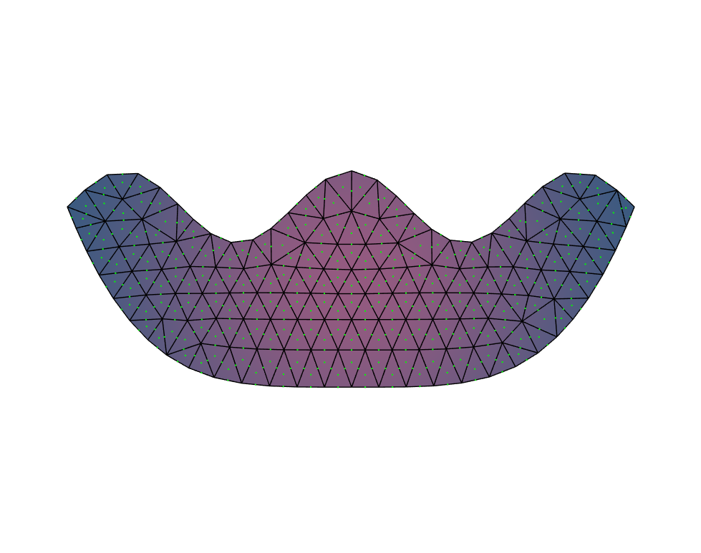
bicycle_seat
 | Bicycle_Seat
 | Jacobian
 | Aspect Ratio | Skew | Taper X | Taper Y
MIN | 1 | -2.04 | -0.661 | -0.659
MEAN | 1.282 | -0.004 | -0.002 | -7.192
MAX | 3.252 | 1.282 | 0.626 | 0.601
 | Shape Parameters
 | Aspect Ratio | Skew | Taper X | Taper Y
MIN | 1.001 | 1.549 | 0.023 | 0.027
MEAN | 1.257 | 1.571 | 0.039 | 0.042
MAX | 2.548 | 1.593 | 0.056 | 0.057

Slide 21
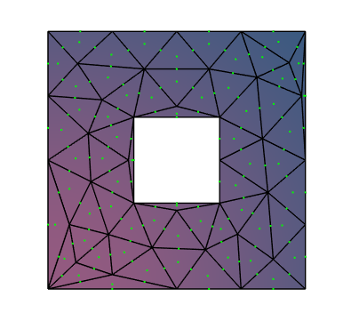
box.2
 | Box.2
 | Jacobian
 | Aspect Ratio | Skew | Taper X | Taper Y
MIN | 1 | -3.557 | -0.642 | -0.709
MEAN | 2.461 | 0.161 | -0.005 | -0.008
MAX | 30.653 | 8.893 | 0.714 | 0.854
 | Shape Parameters
 | Aspect Ratio | Skew | Taper X | Taper Y
MIN | 1 | 1.536 | 0.0147 | 0.016
MEAN | 2.187 | 1.571 | 0.028 | 0.029
MAX | 28.739 | 1.606 | 0.07 | 0.07

Slide 22
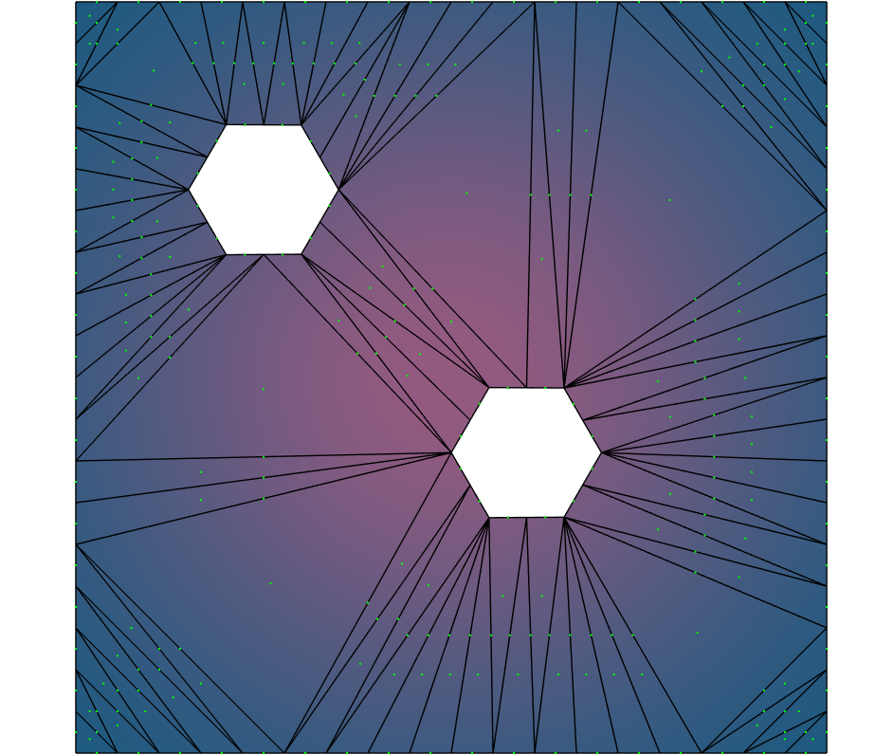
double_hex
 | Double_hex
 | Jacobian
 | Aspect Ratio | Skew | Taper X | Taper Y
MIN | -0.771 | -92.704 | -122.333 | -1667
MEAN | 29.507 | -0.321 | -0.464 | -2.412
MAX | 6945 | 6.203 | 1 | 1001
 | Shape Parameters
 | Aspect Ratio | Skew | Taper X | Taper Y
MIN | 1.079 | 1.563 | 0.002 | 0.002
MEAN | 5.274 | 1.571 | 0.009 | 0.011
MAX | 10.828 | 1.578 | 0.027 | 0.027

Slide 23

square_circle_hole
 | Square_circle_hole
 | Jacobian
 | Aspect Ratio | Skew | Taper X | Taper Y
MIN | 1 | -1.74 | -0.641 | -0.71
MEAN | 1.12 | -0.004 | 0 | 0
MAX | 2.546 | 1.838 | 0.658 | 0.664
 | Shape Parameters
 | Aspect Ratio | Skew | Taper X | Taper Y
MIN | 1 | 1.569 | 0.008 | 0.009
MEAN | 1.122 | 1.571 | 0.012 | 0.012
MAX | 2.001 | 1.573 | 0.017 | 0.018

Slide 24
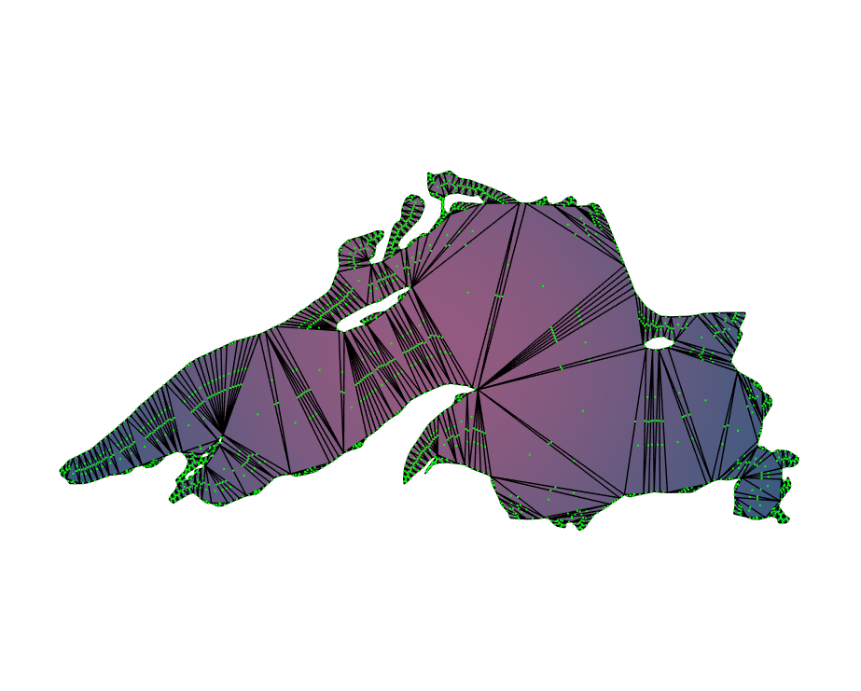
superior.1
 | Superior.1
 | Jacobian
 | Aspect Ratio | Skew | Taper X | Taper Y
MIN | -0.717 | -12.741 | -14.964 | -230.2
MEAN | 6.447 | -0.071 | 0.008 | -0.162
MAX | 3447.867 | 19.254 | 11.038 | 21.046
 | Shape Parameters
 | Aspect Ratio | Skew | Taper X | Taper Y
MIN | 1.021 | 1.57 | 0.0001 | 0.0001
MEAN | 7.416 | 1.571 | 0.001 | 0.002
MAX | 36.788 | 1.572 | 0.011 | 0.011

Slide 25
ADDITIONAL FEATURES & Comparison

Slide 26
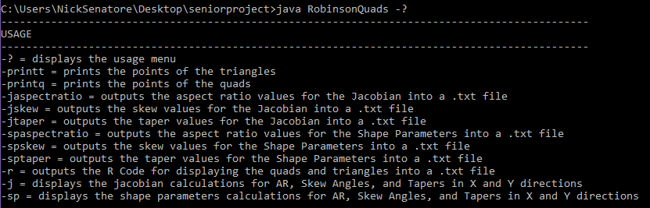
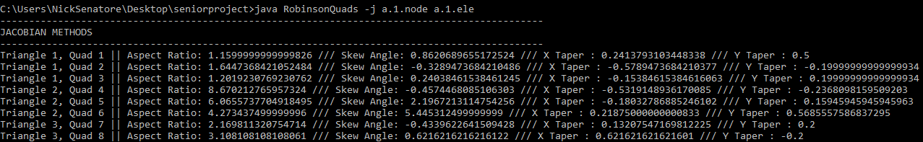
Usage & Output
Display the commands the program offers with -?
Easily output calculations to .txt file or show summary in console
Can specify –v (verbose level) for description within .txt file

Slide 27
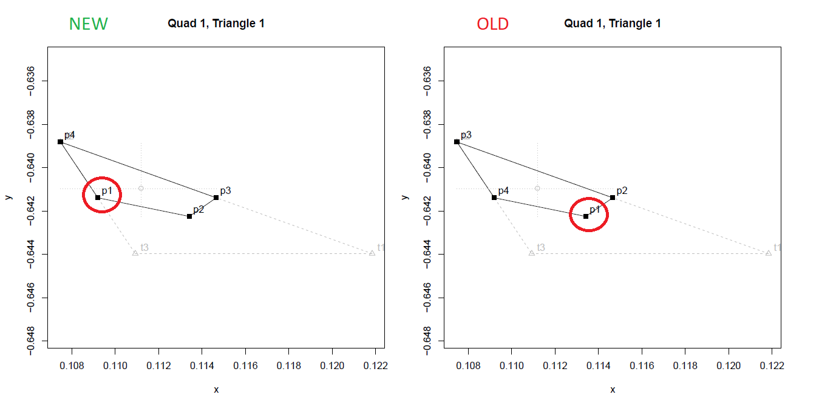
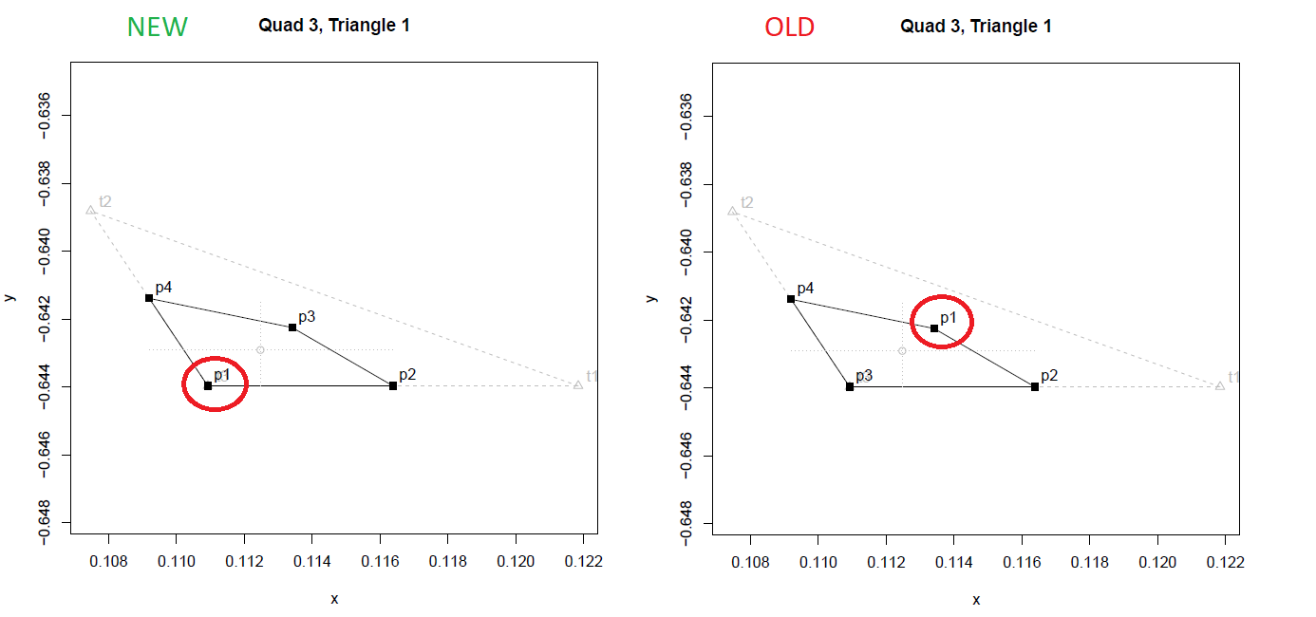
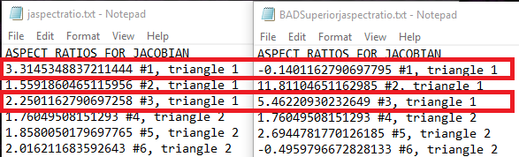
Quad Drawings
(superior example)

Slide 28
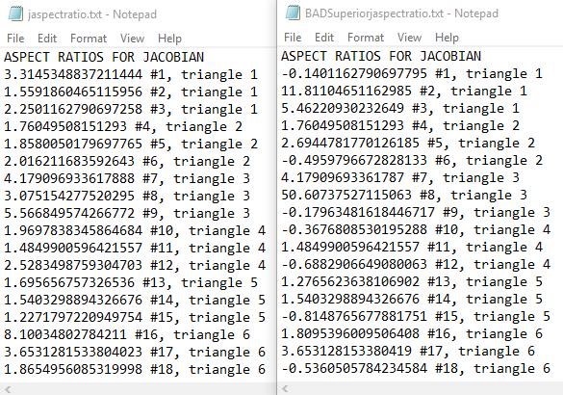
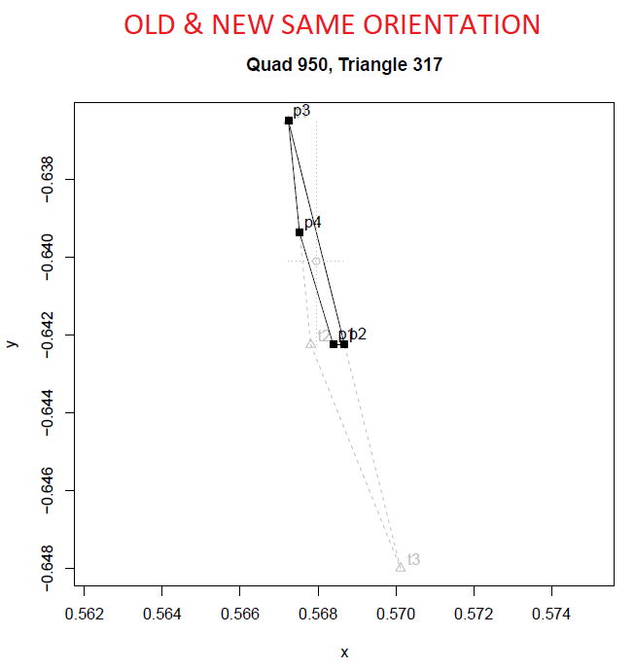
Superior Comparison
All of the Shape Parameters calculations remain the same, Jacobian values differ greatly (due to orientation when calculating e & f)
Looking at the same quad where max of 3447.87 found for old and new

Slide 29
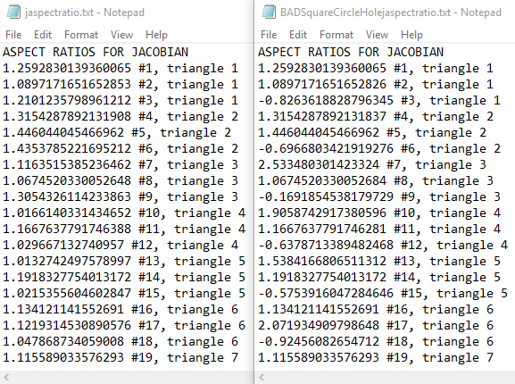
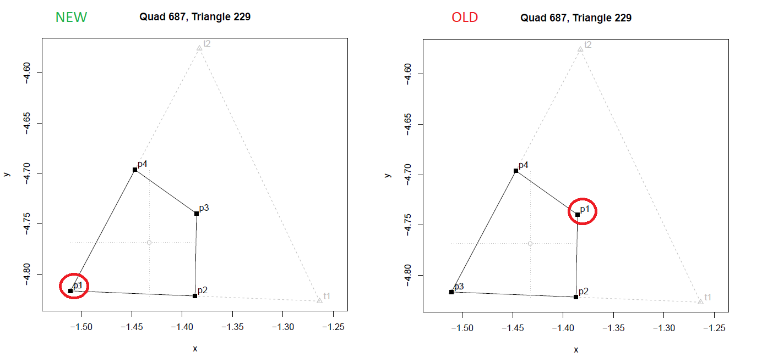
SquareCircleHole Comparison
All of the Shape Parameters calculations remain the same, Jacobian values differ greatly (due to orientation when calculating e & f)
Looking at the same quad where max of 687.685 found for old

Slide 30
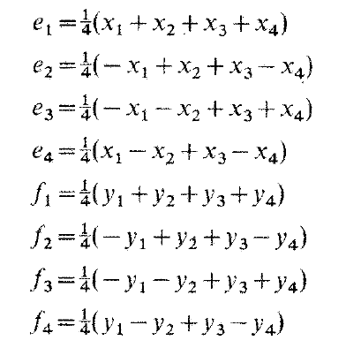
E&F for J.A.R.
Must be done in order to calculate the following properties (1, 2, 3, 4 correspond to points 1, 2, 3, 4 respectively)

Slide 31
Future implementation

Slide 32
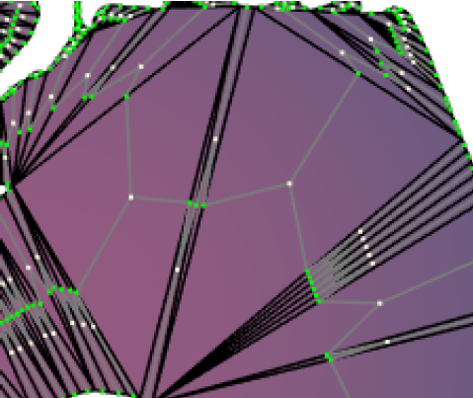
What more for the future?
Further analyze outliers
Minima and maxima
Those outside of some predefined bounds
Look at the triangles they were generated from. Decipher an algorithm to create alternative quads from these triangles to avoid producing these outliers.
Since there are many different measures to evaluate the results, it is anticipated that some alternatives may improve some while others may potentially worsen. An ideal method would of course be one that improves all of them.
Represent the values within a Data Visualization software, such as Tableau

Slide 33
References
cmu. 2018a. .ele files. https://www.cs.cmu.edu/~quake/triangle.ele.html.
cmu. 2018b. .node files. https://www.cs.cmu.edu/~quake/triangle.node.html.
cmu. 2018c. .poly files. https://www.cs.cmu.edu/~quake/triangle.poly.html Coordinate Orientation for Reliable Quadrilateral Shape Parameters WOODSTOCK’18, June, 2018, El Paso, Texas USA
J. Robinson (1987). CRE method of element testing and the Jacobian shape parameters. Engineering Computations 4, 2 (June 1987), 113–118.
J.R. Shewchuk (1996). Triangle: Engineering a 2D Quality Mesh Generator and Delaunay Triangulator. In Applied Computational Geometry: Towards Geometric Engineering, Ming C. Lin and Dinesh Manocha (Eds.). Lecture Notes in Computer Science, Vol. 1148. Springer-Verlag, 203–222. From the First ACM Workshop on Applied Computational Geometry.
J.R. Shewchuk (2002). Delaunay Refinement Algorithms for Triangular Mesh Generation. Computational Geometry: Theory and Applications 22, 1-3 (May 2002), 21–74
J.R. Shewchuk (2005). Triangle - A Two-Dimensional Quality Mesh Generator and Delaunay Triangulator. https://www.cs.cmu.edu/~quake/triangle.html.

Slide 34
Questions?
(Following slides cover methods for calculating Aspect Ratio, Skew, Tapers for Jacobian and Shape Parameters as discussed in Robinson’s paper)

Slide 35
How to calculate?

Slide 36
Method 1 Shape parameters
p. 114

Slide 37
Calculate ARA
Aspect Ratio, according to Figure 5(a)

Slide 38
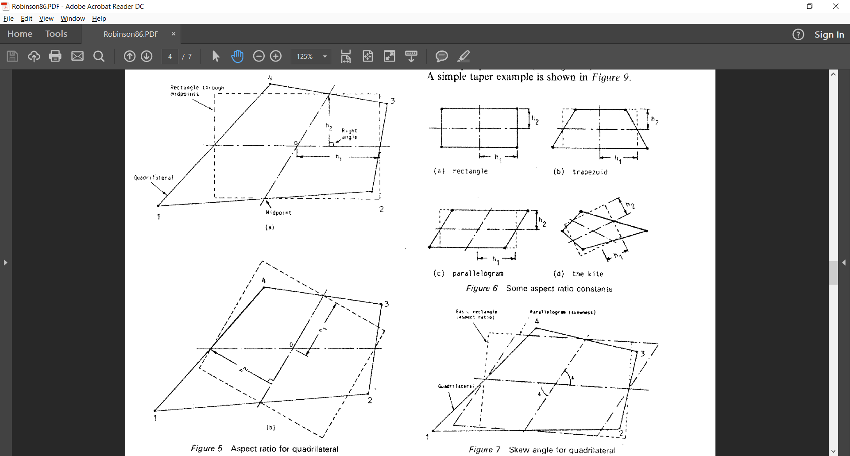
Calculate ARa (p. 114-5)
1. Given points p1, p2, p3, and p4,
calculate midpoints mp12, mp23,
mp34, and mp41.
For example, mp12.x = (p1.x + p2.x) / 2.0
and
mp12.y = (p1.y + p2.y) / 2.0.
mp34
mp41
p
mp23
mp12

Slide 39
Calculate ARa (p. 114-5)
2. Given the two lines defined by
(mp12,mp34) and (mp23,mp41),
find their intersection, point p0.
This may or may not be the centroid.
Determine if it is experimentally by comparing it with the calculated centroid (use closeEnough).
If it appears to be the same experimentally, check algebraically.
mp34
mp41
p
mp23
mp12

Slide 40

Calculate ARa (p. 114-5)
3. Calculate h1 which is the
(Euclidean) distance between the
two points p0 and mp23.
In this case, sqrt((mp23.x – p0.x)^2 + (mp23.y – p0.x)^2)
mp34
mp41
p
mp23
mp12
en.wikipedia.org/wiki/Euclidean_distance#Two_dimensions.

Slide 41

Calculate ARa (p. 114-5)
4. Calculate h2 which is the
distance between the point mp34
and the line formed by mp41 and
mp23.
In this case,
| (mp23.y – mp41.y)mp34.x – (mp23.x – mp41.x)mp34.y + mp23.x*mp41.y – mp23.y*mp41.x | sqrt((mp23.y – mp41.y)^2 + (mp23.x – mp41.x)^2)
mp34
mp41
p
mp23
mp12
en.wikipedia.org/wiki/Distance_from_a_point_to_a_line#Line_defined_by_two_points.

Slide 42
Calculate ARa (p. 114-5)
5. Calculate ARa by finding the maximum value between h1/h2 and h2/h1.
max( h1/h2, h2/h1 )
mp34
mp41
p
mp23
mp12

Slide 43
Calculate ARb
Aspect ratio, according to Figure 5(b)

Slide 44
Calculate ARb (p. 114-5)
Assuming previous steps were followed (calculated midpoints, centroid)
1. Calculate h1 which is the
(Euclidean) distance between the
two points p0 and mp34.
In this case, sqrt((mp34.x – p0.x)^2 + (mp34.y – p0.x)^2)
mp34
mp41
p
mp23
mp12
en.wikipedia.org/wiki/Euclidean_distance#Two_dimensions.

Slide 45
Calculate ARb (p. 114-5)
2. Calculate h2 which is the
distance between the point mp41
and the line formed by mp12 and
mp34.
In this case,
| (mp34.y – mp12.y)mp41.x – (mp34.x – mp12.x)mp41.y + mp34.x*mp12.y – mp34.y*mp12.x | sqrt((mp34.y – mp12.y)^2 + (mp34.x – mp12.x)^2)
mp34
mp41
p
mp23
mp12
en.wikipedia.org/wiki/Distance_from_a_point_to_a_line#Line_defined_by_two_points.

Slide 46
Calculate ARb (p. 114-5)
3. Calculate ARb by finding the maximum value between h1/h2 and h2/h1.
max( h1/h2, h2/h1 )
mp34
mp41
p
mp23
mp12

Slide 47
Calculate AR

Slide 48
Calculate AR
Simply find the maximum between ARa and ARb. The maximum value will be your aspect ratio.
AR = max( ARa, ARb )

Slide 49
Calculate skew angle
Figure 7

Slide 50
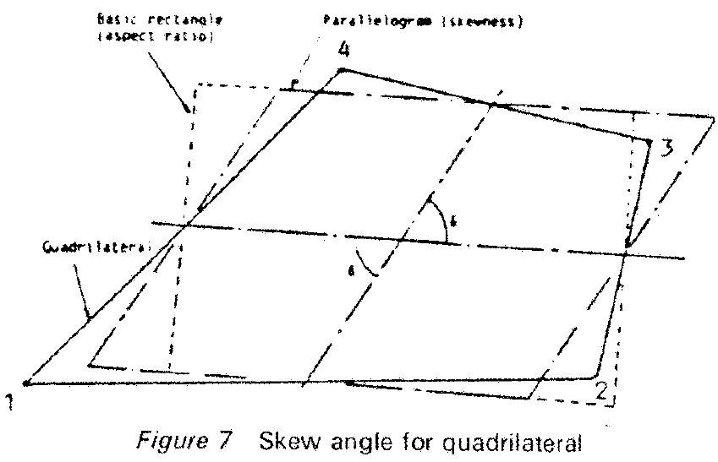
Calculate Skew Angle (p. 115)
Calculate dot product to get the angle
between two vectors.
1. Subtract p0 from mp23 and mp34 to yield vectors mp23’ and mp34’.
mp34
mp41
P0
mp23
mp12

Slide 51

Calculate Skew Angle (p. 115)
Calculate dot product to get the angle
between two vectors.
2. Calculate dot product In this case, mp23’.x * mp34’.x + mp23’.y * mp34’.y
mp34
mp41
P0
mp23
mp12
en.wikipedia.org/wiki/Dot_product#Geometric_definition).

Slide 52
Calculate Skew Angle (p. 115)
Calculate dot product to get the angle
between two vectors.
3. Dot product result is cos of angle. Use acos of dot product to get angle.
(Be careful about degrees vs. radians, negative angles, and min(skew, π-skew) (or min(skew, 180°-skew))
acos(mp23’ * mp34’)
mp34
mp41
P0
mp23
mp12

Slide 53
Calculate X & Y tapers

Slide 54
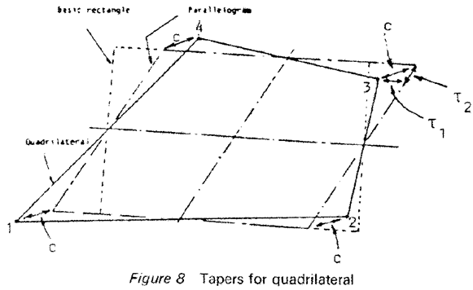

Calculate X & Y Tapers (p. 115)
Objective is to calculate T1 and T2.
1. Given the two points, mp41 and mp23, calculate the slope of the line between them. In this case, mp23.y – mp41.y mp23.x – mp41.x
mp34
mp41
P0
mp23
mp12
en.wikipedia.org/wiki/Slope

Slide 55
Calculate X & Y Tapers (p. 115)
Objective is to calculate T1 and T2.
2. Use the slope from the previous step (from the line between mp41 and mp23) and the point p3 to determine the line through p3 and parallel to the line between mp41 and mp23.
In this case, y – p3.y = mp41_mp23m(x – p3.x)
mp34
mp41
P0
mp23
mp12
en.wikipedia.org/wiki/Linear_equation#Point.E2.80.93slope_form

Slide 56
Calculate X & Y Tapers (p. 115)
Objective is to calculate T1 and T2.
3. Given the two points, mp12 and mp34, calculate the slope of the line between them. In this case, mp34.y – mp12.y mp34.x – mp12.x
mp34
mp41
P0
mp23
mp12
en.wikipedia.org/wiki/Slope

Slide 57
Calculate X & Y Tapers (p. 115)
Objective is to calculate T1 and T2.
4. Use the slope from the previous step (from the line between mp41 and mp23) and the point mp23 to determine the line through mp23 and parallel to the line between mp12 and mp34.
In this case, y – mp23.y = mp12_mp34m(x – mp23.x)
mp34
mp41
P0
mp23
mp12
en.wikipedia.org/wiki/Linear_equation#Point.E2.80.93slope_form

Slide 58

Calculate X & Y Tapers (p. 115)
Objective is to calculate T1 and T2.
5. Calculate the point of intersection between the two lines as shown. Call it pt1.
y = ax + c and y = bx + d y = mp41_mp23m(x – p3.x) + p3.y y = mp12_mp34m(x – mp23.x) + mp23.y In this case, P ( mp23.y – p3.y , (mp41_mp23m * mp23.y) – (mp12_mp34m * p3.y) ) mp41_mp23m – mp12_mp34m mp41_mp23m – mp12_mp34m
mp34
pt1
mp41
P0
mp23
mp12
en.wikipedia.org/wiki/Line%E2%80%93line_intersection#Given_the_equations_of_the_lines.

Slide 59
Calculate X & Y Tapers (p. 115)
Objective is to calculate T1 and T2.
6. Calculate T1 as the distance between p3 and the point, pt1. In this case, sqrt((pt1.x – p3.x)^2 + (pt1.y – p3.y)^2)
mp34
pt1
mp41
P0
mp23
mp12
en.wikipedia.org/wiki/Euclidean_distance#Two_dimensions

Slide 60
Calculate X & Y Tapers (p. 115)
Objective is to calculate T1 and T2.
7. Use the slope from the previous step (from the line between mp41 and mp23) and the point mp34 to determine the line through mp34 and parallel to the line between mp41 and mp23.
In this case, y – mp34.y = mp41_mp23m(x – mp34.x)
mp34
mp41
P0
mp23
mp12
en.wikipedia.org/wiki/Linear_equation#Point.E2.80.93slope_form

Slide 61
Calculate X & Y Tapers (p. 115)
Objective is to calculate T1 and T2.
8. Calculate the point of intersection between the two lines as shown. Call it pt2.
y = ax + c and y = bx + d y = mp41_mp23m(x – mp34.x) + mp34.y y = mp12_mp34m(x – mp23.x) + mp23.y In this case, P ( mp23.y – mp34.y , (mp41_mp23m * mp23.y) – (mp12_mp34m * mp34.y) ) mp41_mp23m – mp12_mp34m mp41_mp23m – mp12_mp34m
mp34
pt2
mp41
P0
mp23
mp12
en.wikipedia.org/wiki/Line%E2%80%93line_intersection#Given_the_equations_of_the_lines.

Slide 62
Calculate X & Y Tapers (p. 115)
Objective is to calculate T1 and T2.
9. Calculate T2 as the distance between points pt1 and pt2.
In this case, sqrt((pt2.x – p1.x)^2 + (pt2.y – p1.y)^2)
mp34
pt2
pt1
mp41
P0
mp23
mp12
en.wikipedia.org/wiki/Euclidean_distance#Two_dimensions

Slide 63
Method 2 Jacobian matrix
p. 116

Slide 64
Vital Calculations
Must be done in order to calculate the following properties (1, 2, 3, 4 correspond to points 1, 2, 3, 4 respectively)

Slide 65
Calculate AR
Figure 12(a)

Slide 66
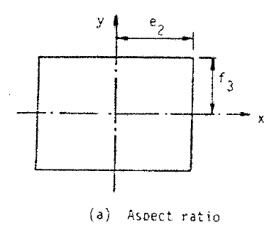
Calculate AR (p. 116-117)
Find the maximum value between e2/f3 and f3/e2
max( e2/f3, f3/e2 ) [equation 11]

Slide 67
Calculate skew angle
Figure 12(b)

Slide 68
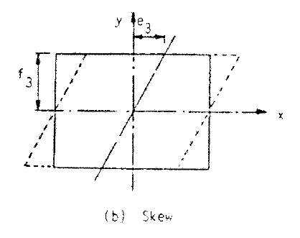
Calculate Skew Angle (p. 116-117)
Divide e3 by f3
e3/f3 [equation 12]

Slide 69
Calculate X & Y Tapers
Figure 12(c,d)

Slide 70
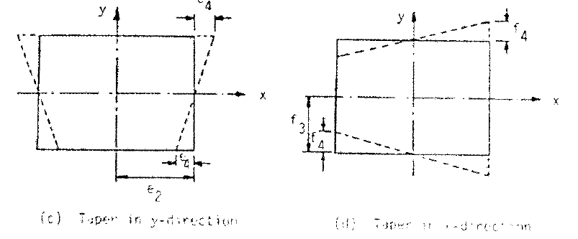
Calculate X & Y Tapers (p. 116-117)
Taper X = Divide f4 by f3
Taper Y = Divide e4 by e2
Taper X = f4 / f3 [equation 13]
Taper Y = e4 / e2 [equation 14]

